Slide 1
Scientific Machine Learning for Modeling, Optimization, and Control
Ján Drgoňa
Associate Professor Civil and Systems Engineering Department Electrical and Computer Engineering Department (secondary) The Ralph O'Connor Sustainable Energy Institute (ROSEI)
Data Science and AI Institute (DSAI)

Slide 2
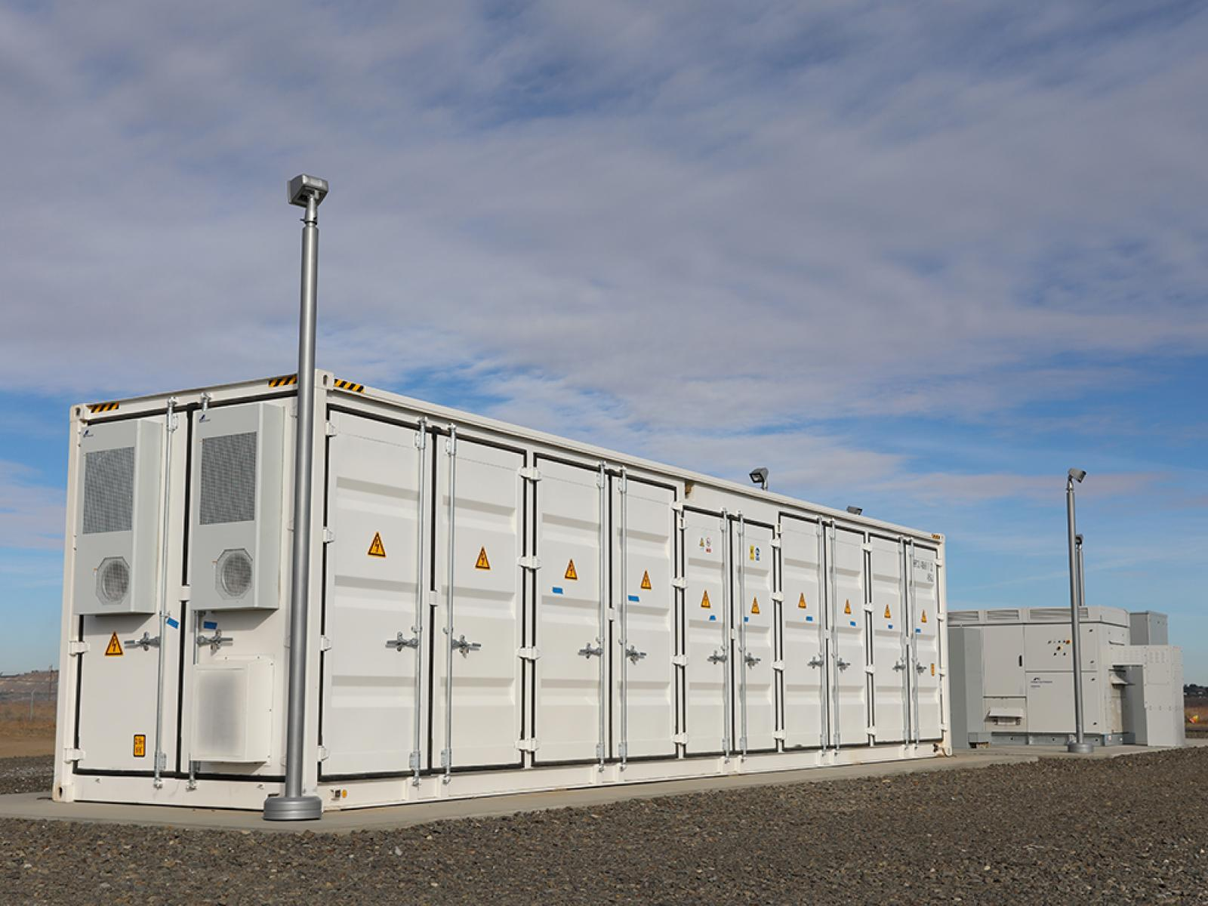

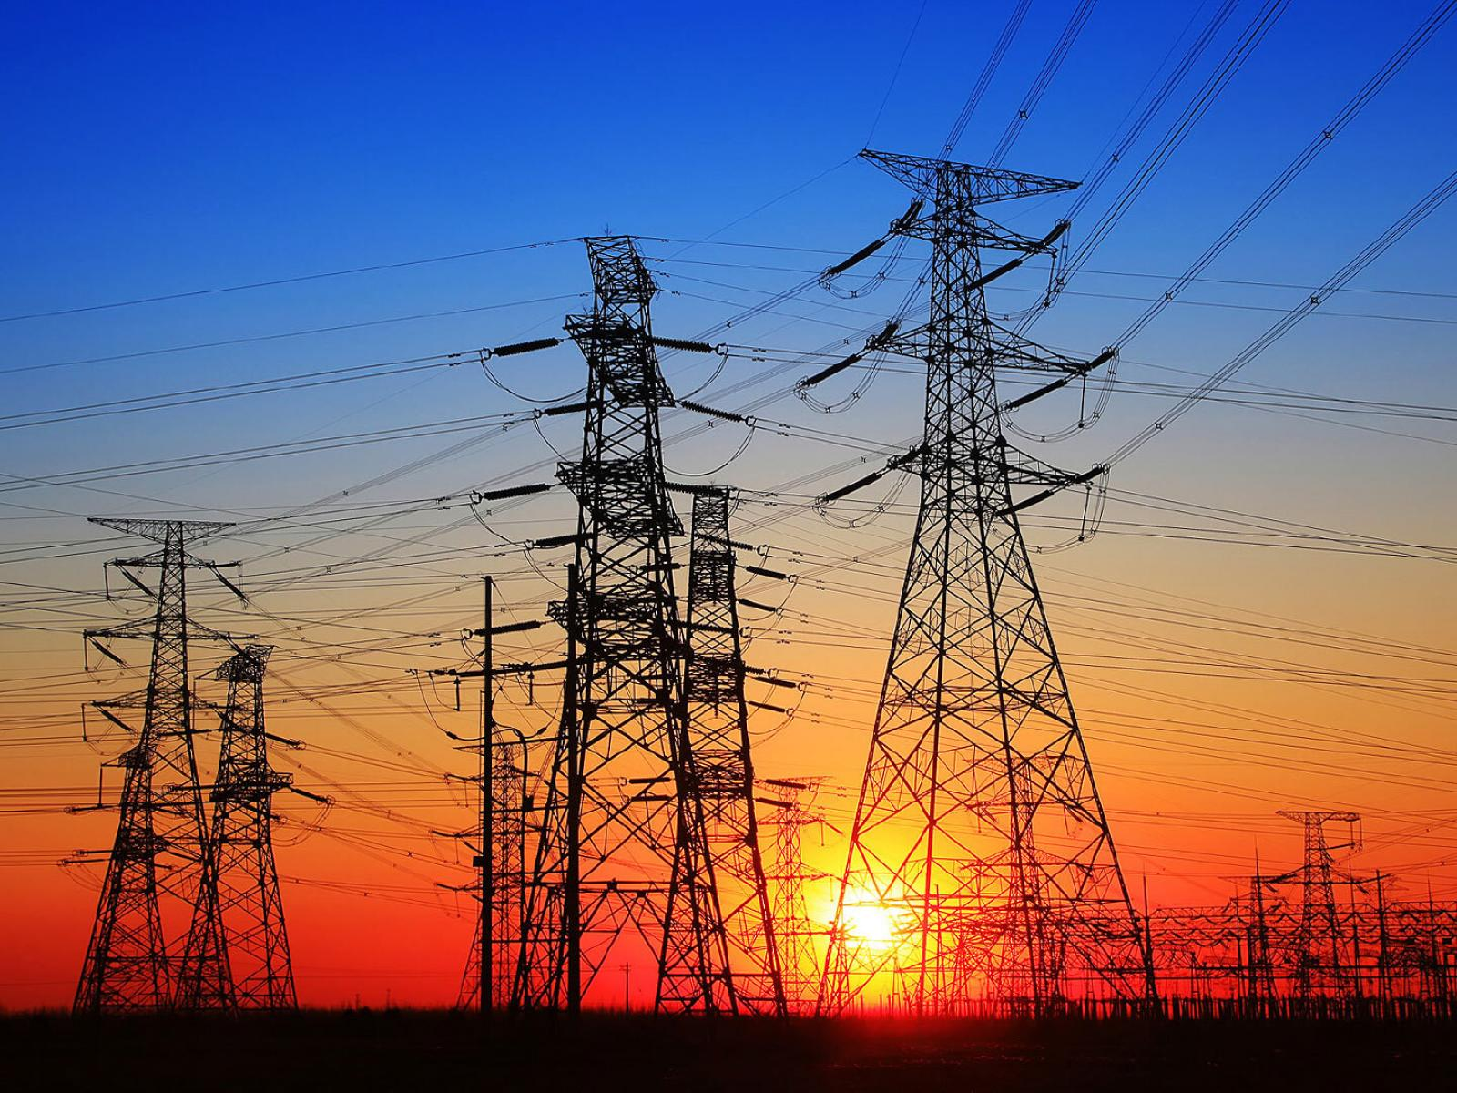

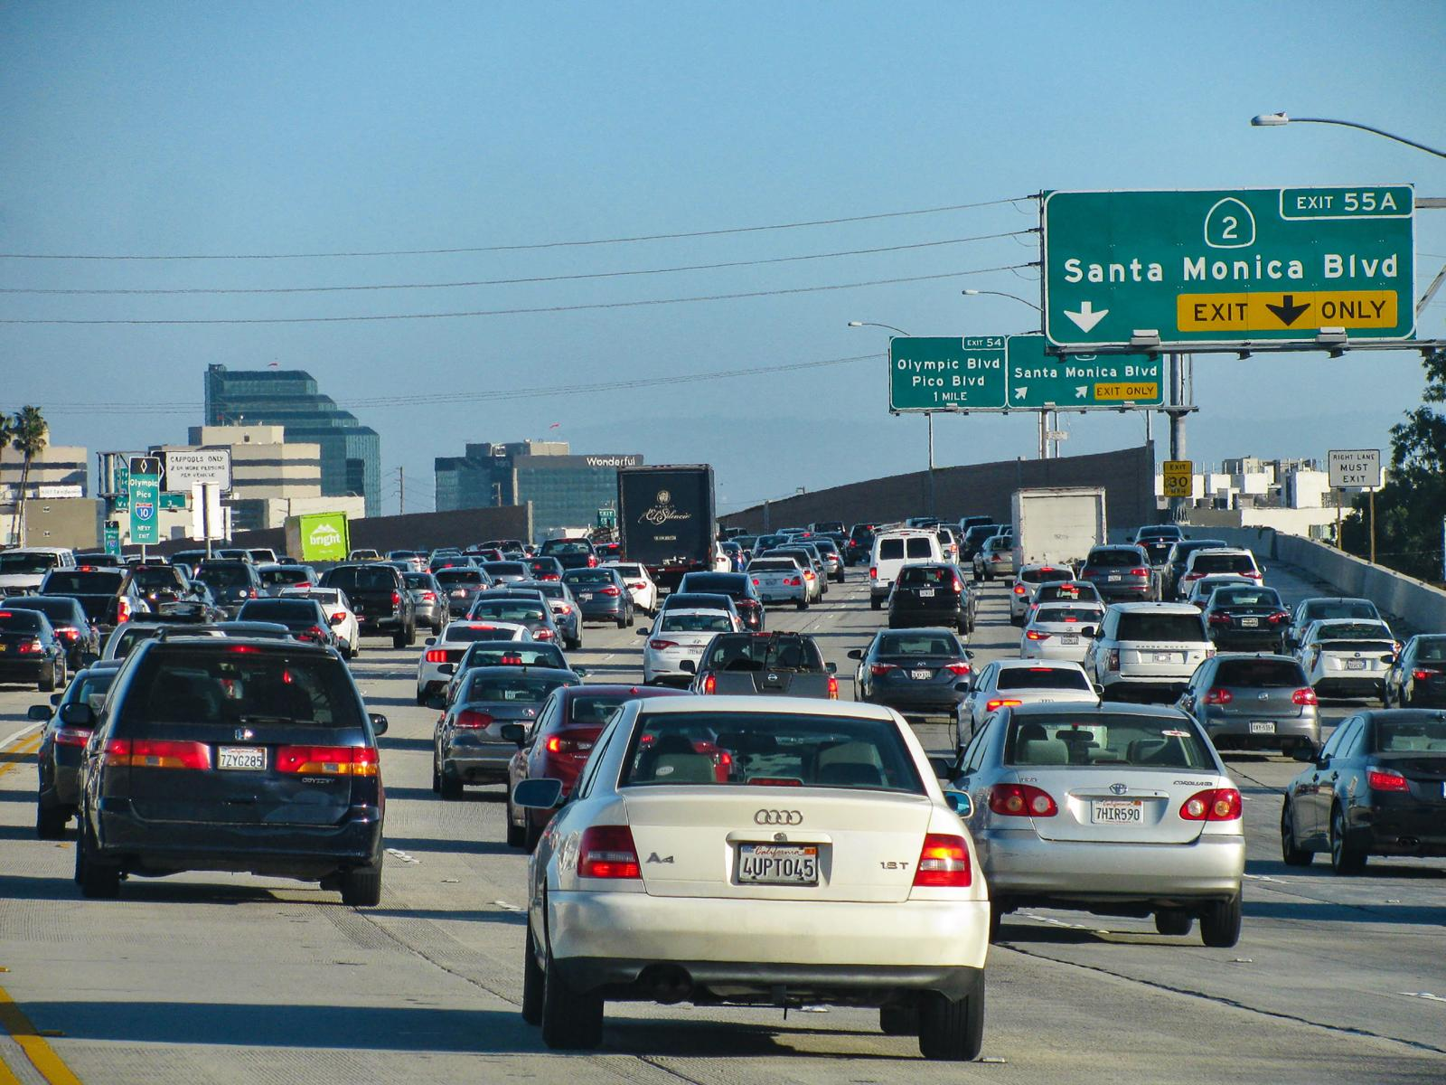
Optimizing Complex Systems is Hard
Simulations are crucial for optimal decision-making in complex energy systems
Need: Improve computational efficiency and scalability of digital twins and optimization-based decision-making
Challenges:
Modeling and simulation of complex systems is hard
Closed-loop decision-making for complex systems is hard-er
Scientific computing and machine learning tools are fragmented and not easily composable
Safety guarantees are critical

Slide 3

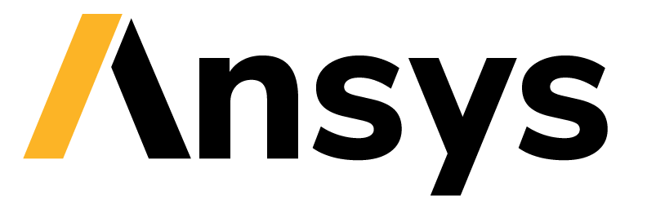










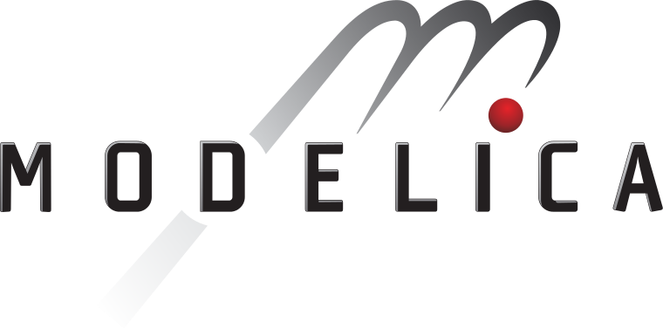
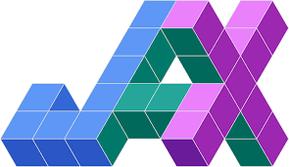


Challenge: Heterogenous Software Tools
Constrained Optimization
Differential Equations
Supervised Learning
Reinforcement Learning
More domain knowledge
Less domain knowledge

Slide 4
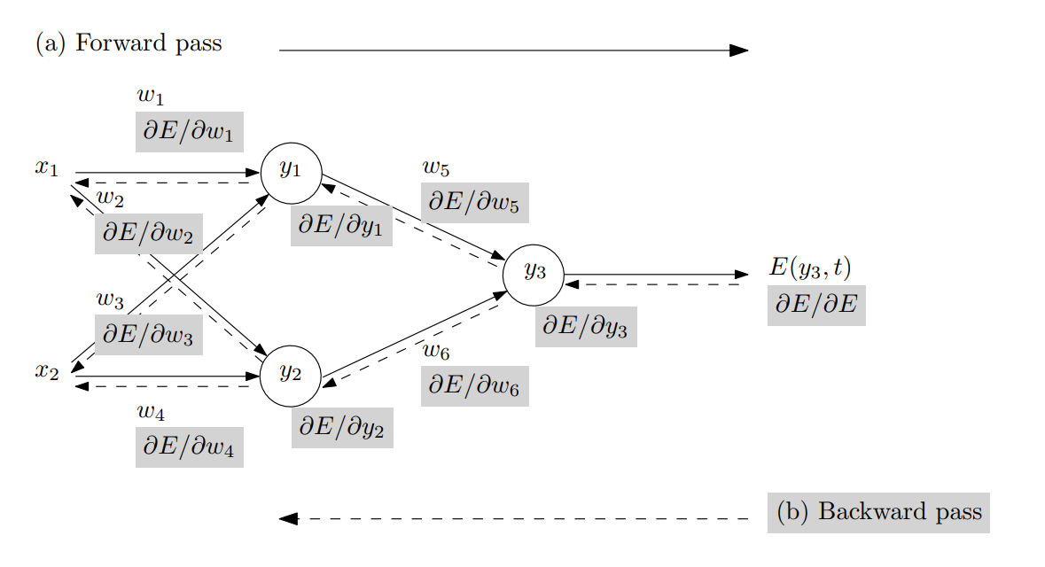
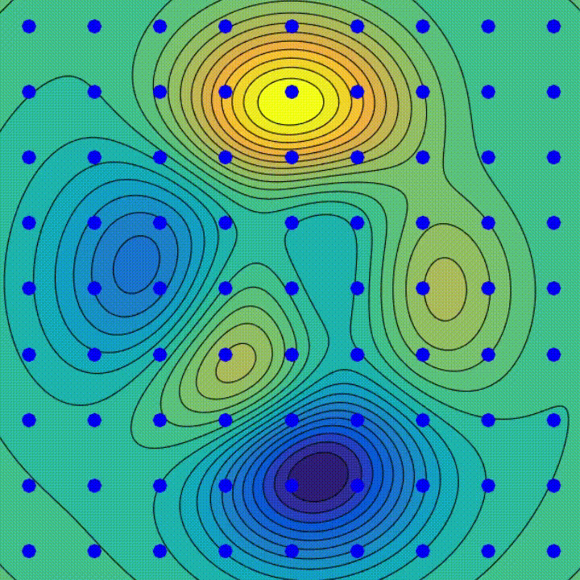
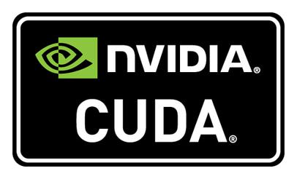

Automatic Differentiation (AD) in Machine Learning
AD enables efficient computation of derivatives for differentiable programs, which is fundamental for training complex ML models using GPUs.
Backpropagation Algorithm
Gradient Descent Algorithm
SW and HW Innovations
Animation source: wikipedia
Baydin, Atilim Gunes et al. Automatic differentiation in machine learning: a survey. Journal of Machine Learning Research, 2015

Slide 5
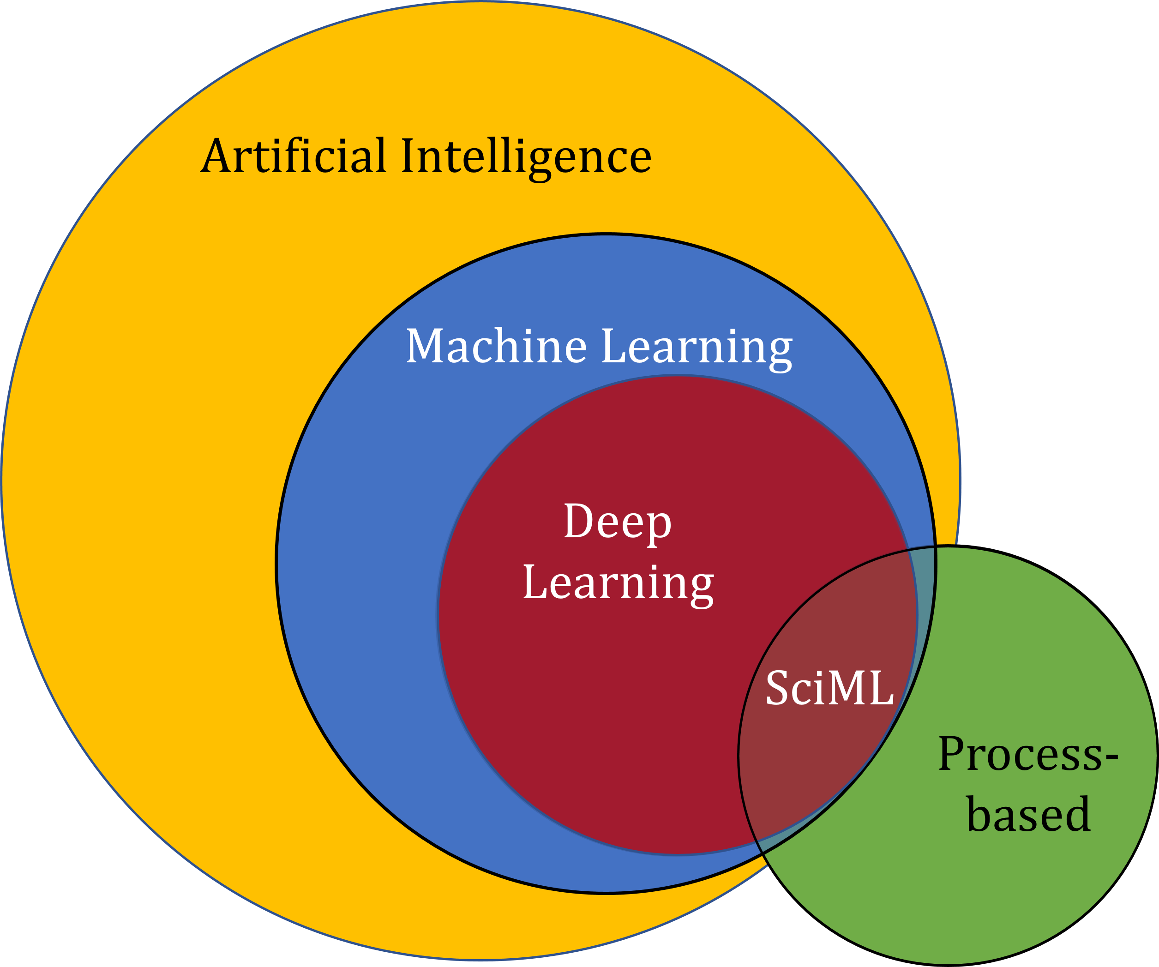
Scientific Machine Learning (SciML)
What?
SciML systematically integrates ML methods with mathematical models and algorithms developed in various scientific and engineering domains
Why?
Scientific applications are governed by fundamental principles and physical constraints
Purely data-driven “black box” ML methods cannot satisfy underlying physics
How?
Leverage automatic differentiation used in learning for modeling, optimization, and control
Karniadakis, G.E., Kevrekidis, I.G., Lu, L. et al. Physics-informed machine learning. Nat Rev Phys 3, 422–440, 2021.
Image source: https://sciml.wur.nl/reviews/sciml/sciml.html

Slide 6
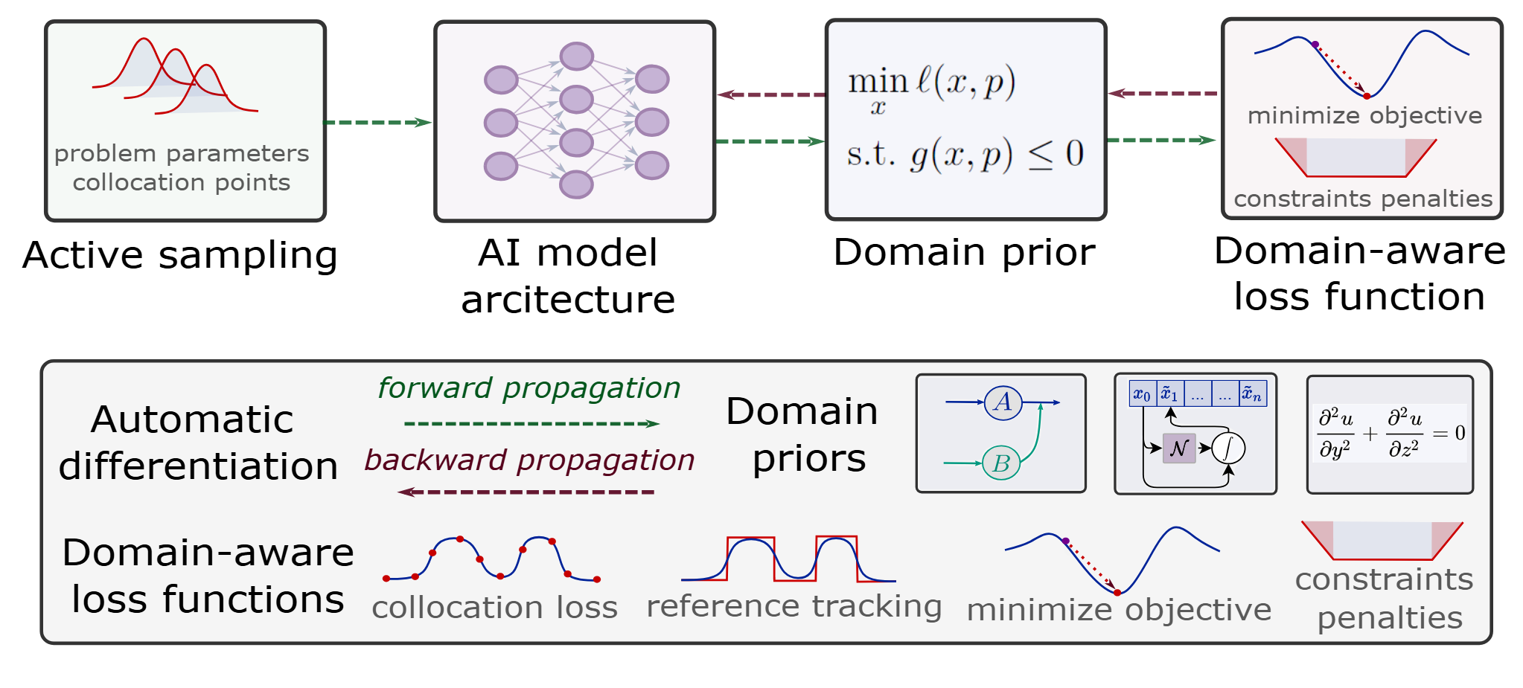
Components of Scientific Machine Learning
Karniadakis, G.E., Kevrekidis, I.G., Lu, L. et al. Physics-informed machine learning. Nat Rev Phys 3, 2021.
Thiyagalingam, J., Shankar, M., Fox, G. et al. Scientific machine learning benchmarks. Nature Reviews Physics 4, 413–420, 2022.
Nghiem T., Drgona J., et al. Physics-Informed Machine Learning for Modeling and Control of Dynamical Systems, ACC, 2023.

Slide 7

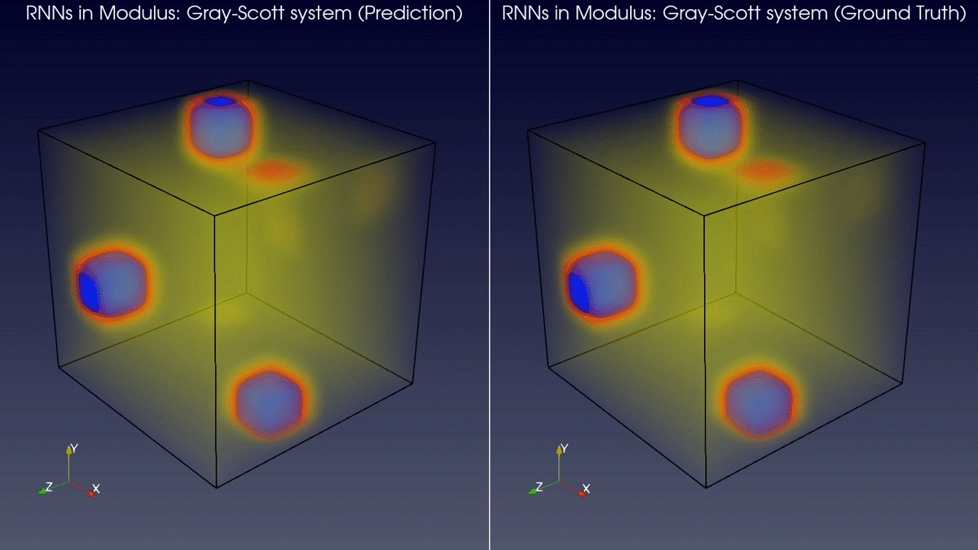
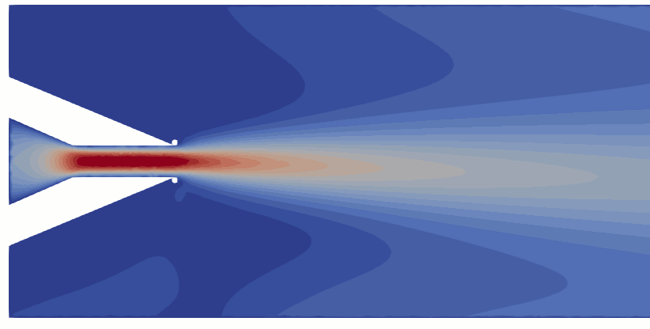
Learning to Solve Differential Equations with Physics-Informed Neural Networks (PINNs)
Training neural networks as PDE solutions
Application: Parameter estimation from data
M. Raissi, et al., Physics-informed neural networks: A deep learning framework for solving forward and inverse problems involving nonlinear partial differential equations, Journal of Computational Physics, 2019
Images: NVIDIA Modulus

Slide 8
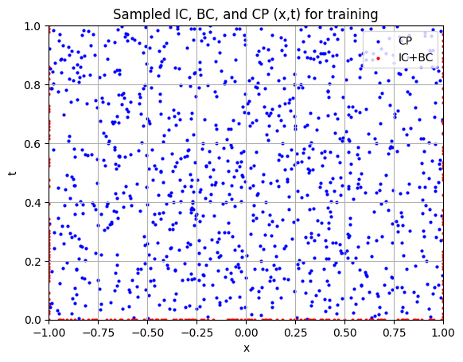
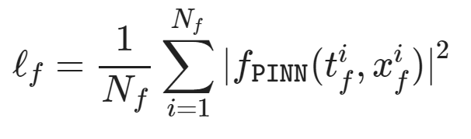
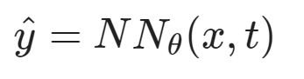
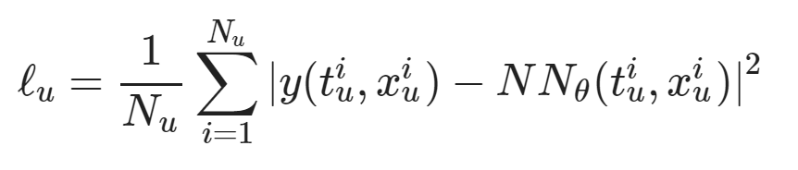
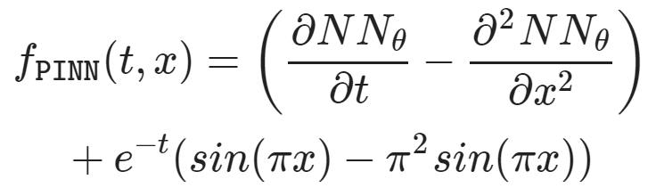
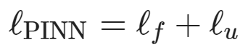
Learning to Solve Differential Equations with Physics-Informed Neural Networks (PINNs)
Dataset: collocation points in the spatio-temporal coordinates.
Architecture: PDE equations solved with neural network via automatic differentiation.
Loss function: minimizing PDE equation, initial and boundary condition residuals.
https://github.com/pnnl/neuromancer/blob/master/examples/PDEs/Part_2_PINN_BurgersEquation.ipynb
M. Raissi, et al., Physics-informed neural networks: A deep learning framework for solving forward and inverse problems involving nonlinear partial differential equations, Journal of Computational Physics, 2019

Slide 9
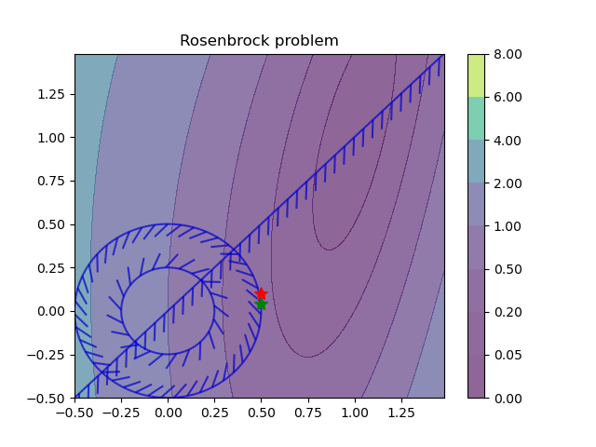
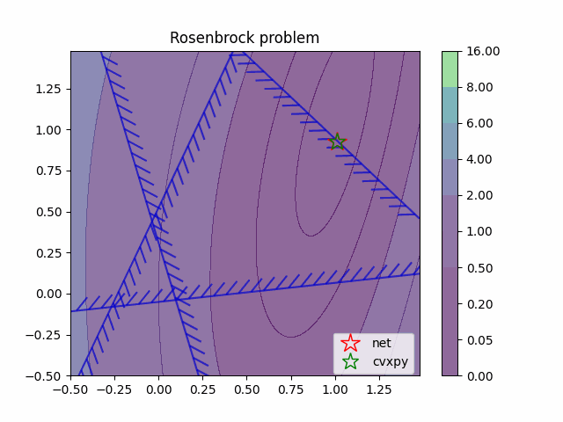
Learning to Optimize (L2O) with Constraints
Training neural networks as optimization solutions
Application: solving optimal power flow
James Kotary, et al., End-to-End Constrained Optimization Learning: A Survey, IJCAI, 2021

Slide 10
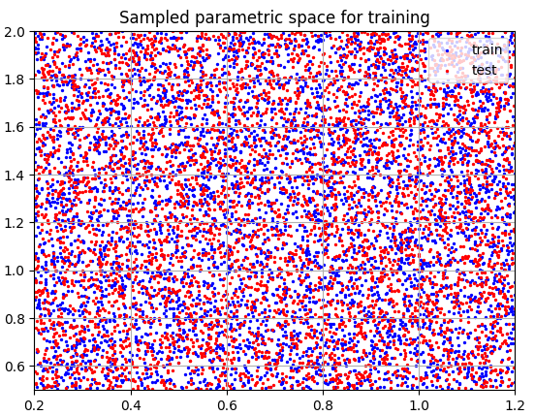
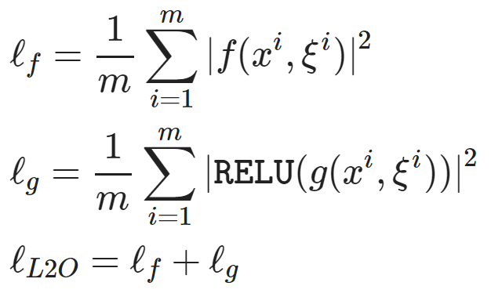
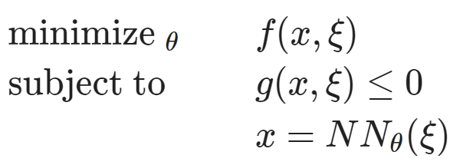
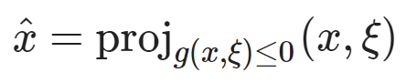
Learning to Optimize (L2O) with Constraints
Dataset: collocation points in the parametric space.
Architecture: differentiable optimization solver with neural network surrogate.
Loss function: minimizing objective function and constraints penalties.
https://github.com/pnnl/neuromancer/blob/master/examples/parametric_programming/Part_1_basics.ipynb
A. Agrawal, et al., Differentiable Convex Optimization Layers, 2019
P. Donti, et al., DC3: A learning method for optimization with hard constraints, 2021

Slide 11
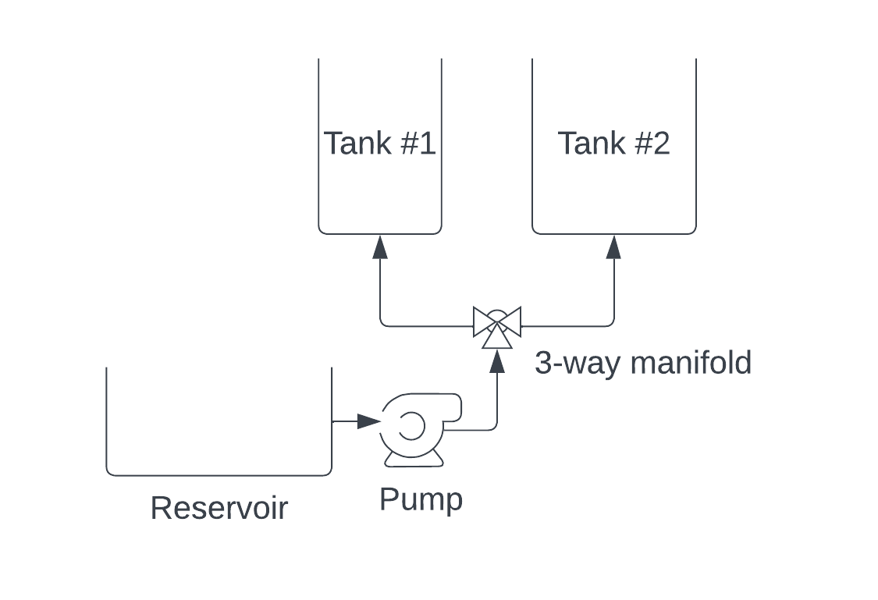
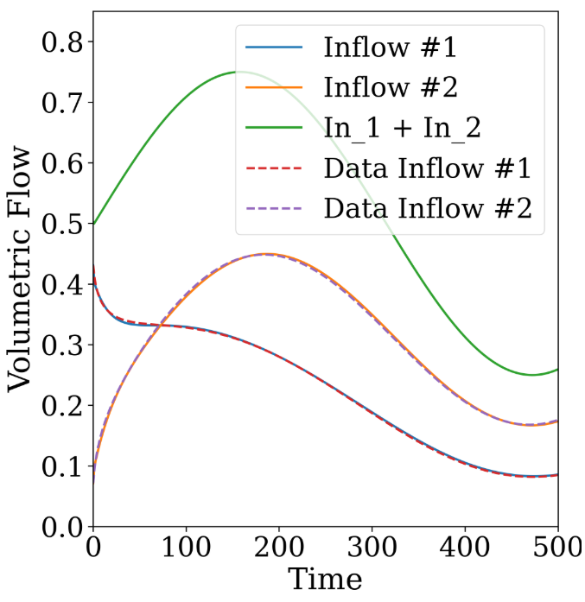
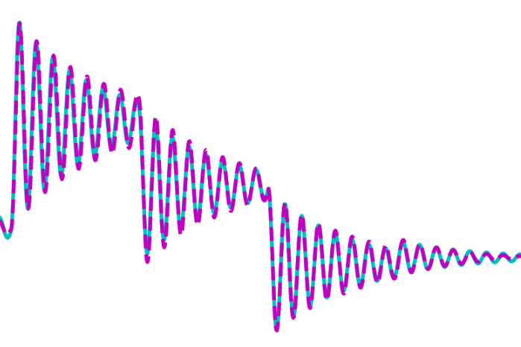
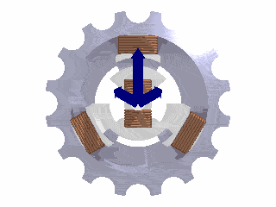
Learning to Model (L2M) Dynamical Systems
Nonlinear system identification
Applications: modeling process dynamics
R. T. Q. Chen, et al., Neural ordinary differential equations. NeurIPS, 2018
C. Rackauckas, et al., Universal Differential Equations for Scientific Machine Learning, 2021
James Koch, et al., Learning Neural Differential Algebraic Equations via Operator Splitting, CDC, 2025

Slide 12
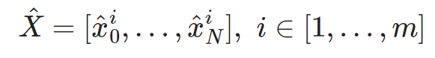
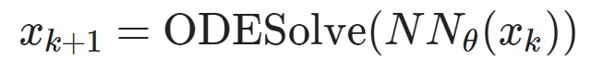
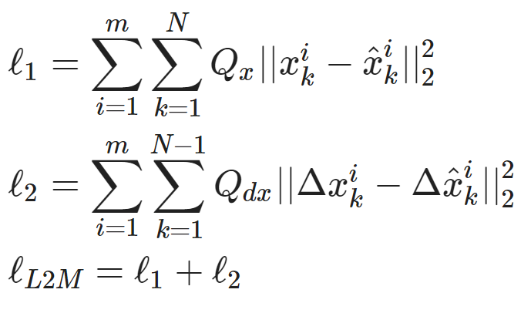
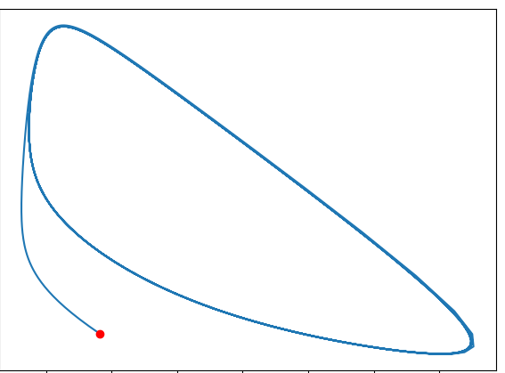
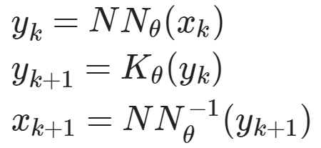
Learning to Model (L2M) Dynamical Systems
Dataset: time-series of states, inputs, and disturbances tuples.
Architecture: differentiable ODE solver with neural network model.
Loss function: trajectory matching, regularizations, and constraints penalties.
Architecture: Koopman operator with learned basis functions.
https://github.com/pnnl/neuromancer/blob/master/examples/ODEs/Part_1_NODE.ipynb
R. T. Q. Chen, et al., Neural Ordinary Differential Equations, 2019
Milan Korda, Igor Mezić, Linear predictors for nonlinear dynamical systems: Koopman operator meets model predictive control, Automatica, 2018

Slide 13
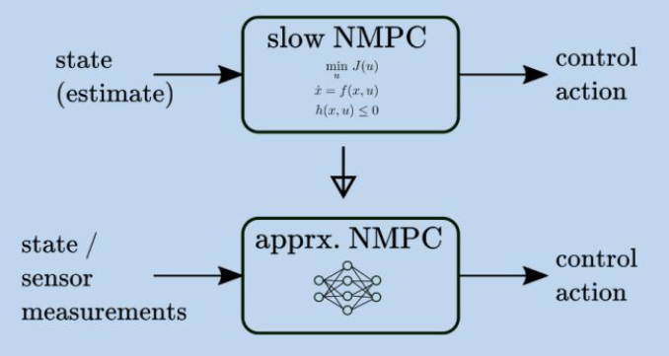
Learning to Control (L2C) Methodologies
Supervised L2C: Approximate Model Predictive Control
M. Hertneck, et al., "Learning an Approximate Model Predictive Controller With Guarantees," in IEEE Control Systems Letters, 2018
B. Karg and S. Lucia, "Efficient Representation and Approximation of Model Predictive Control Laws via Deep Learning," in IEEE Transactions on Cybernetics, 2020
Self-Supervised L2C: Differentiable Predictive Control (DPC)
J. Drgoňa, A. Tuor and D. Vrabie, "Learning Constrained Parametric Differentiable Predictive Control Policies With Guarantees," in IEEE Transactions on Systems, Man, and Cybernetics: Systems, 2024
Ján Drgoňa, et al, Differentiable predictive control: Deep learning alternative to explicit model predictive control for unknown nonlinear systems, Journal of Process Control, 2022

Slide 14
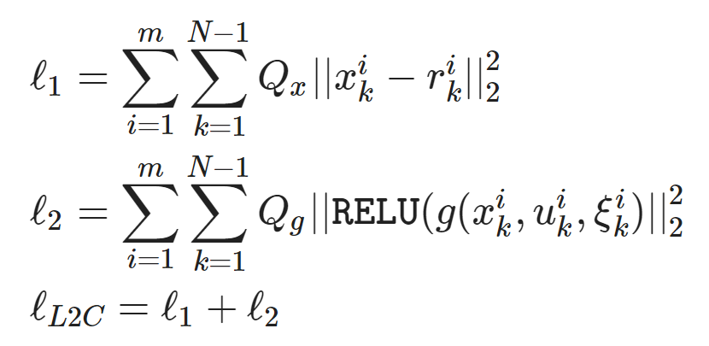
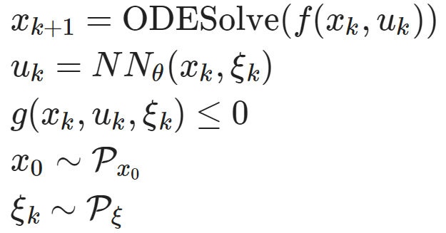
Self-Supervised L2C: Differentiable Predictive Control (DPC)
Dataset: collocation points in the control parametric space.
Architecture: differentiable model with neural network control policy.
Loss function: reference tracking, constraints and terminal penalties.
https://github.com/pnnl/neuromancer/blob/master/examples/control/Part_3_ref_tracking_ODE.ipynb
J. Drgoňa, A. Tuor and D. Vrabie, "Learning Constrained Parametric Differentiable Predictive Control Policies With Guarantees," in IEEE Transactions on Systems, Man, and Cybernetics: Systems, 2024

Slide 15
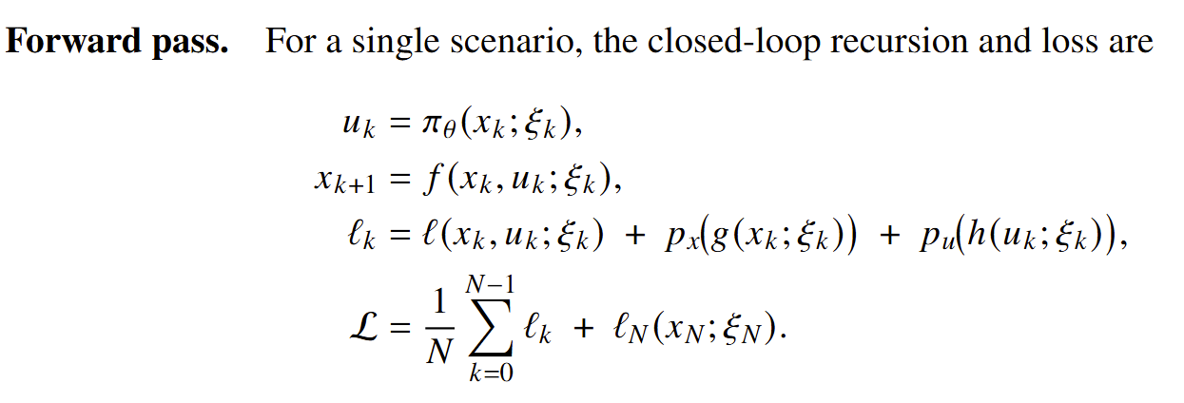
Differentiable Closed-Loop System

Slide 16
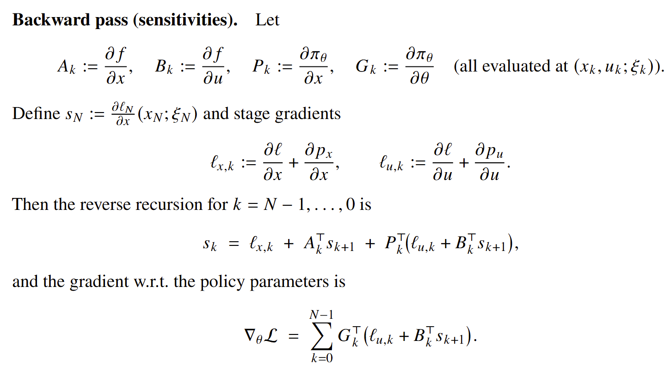
Differentiable Closed-Loop System

Slide 17
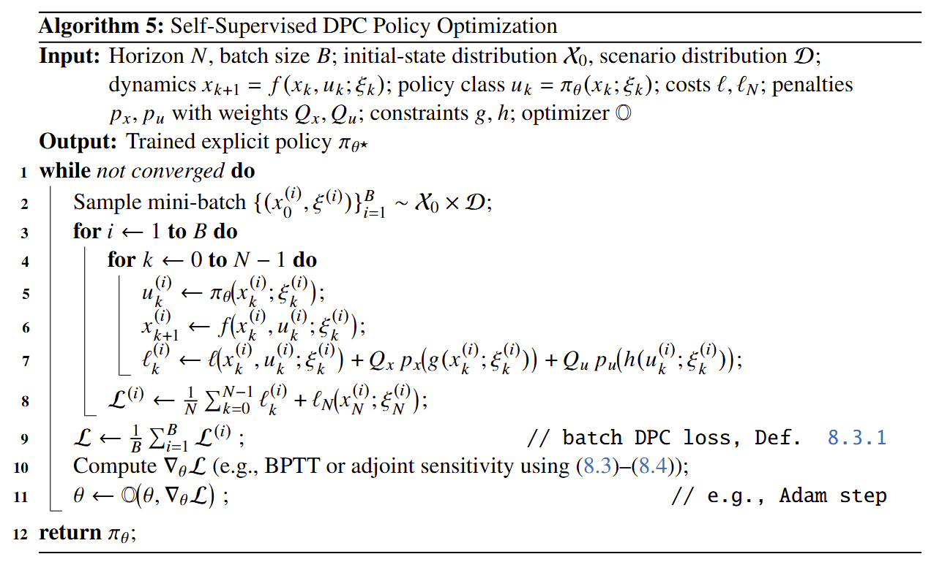
DPC Policy Optimization Algorithm

Slide 18

NeuroMANCER Scientific Machine Learning Library
Open-source library in PyTorch
Physics-informed Neural Networks
Learning to optimize
Neural differential equations
Learning to control
github.com/pnnl/neuromancer

Slide 19
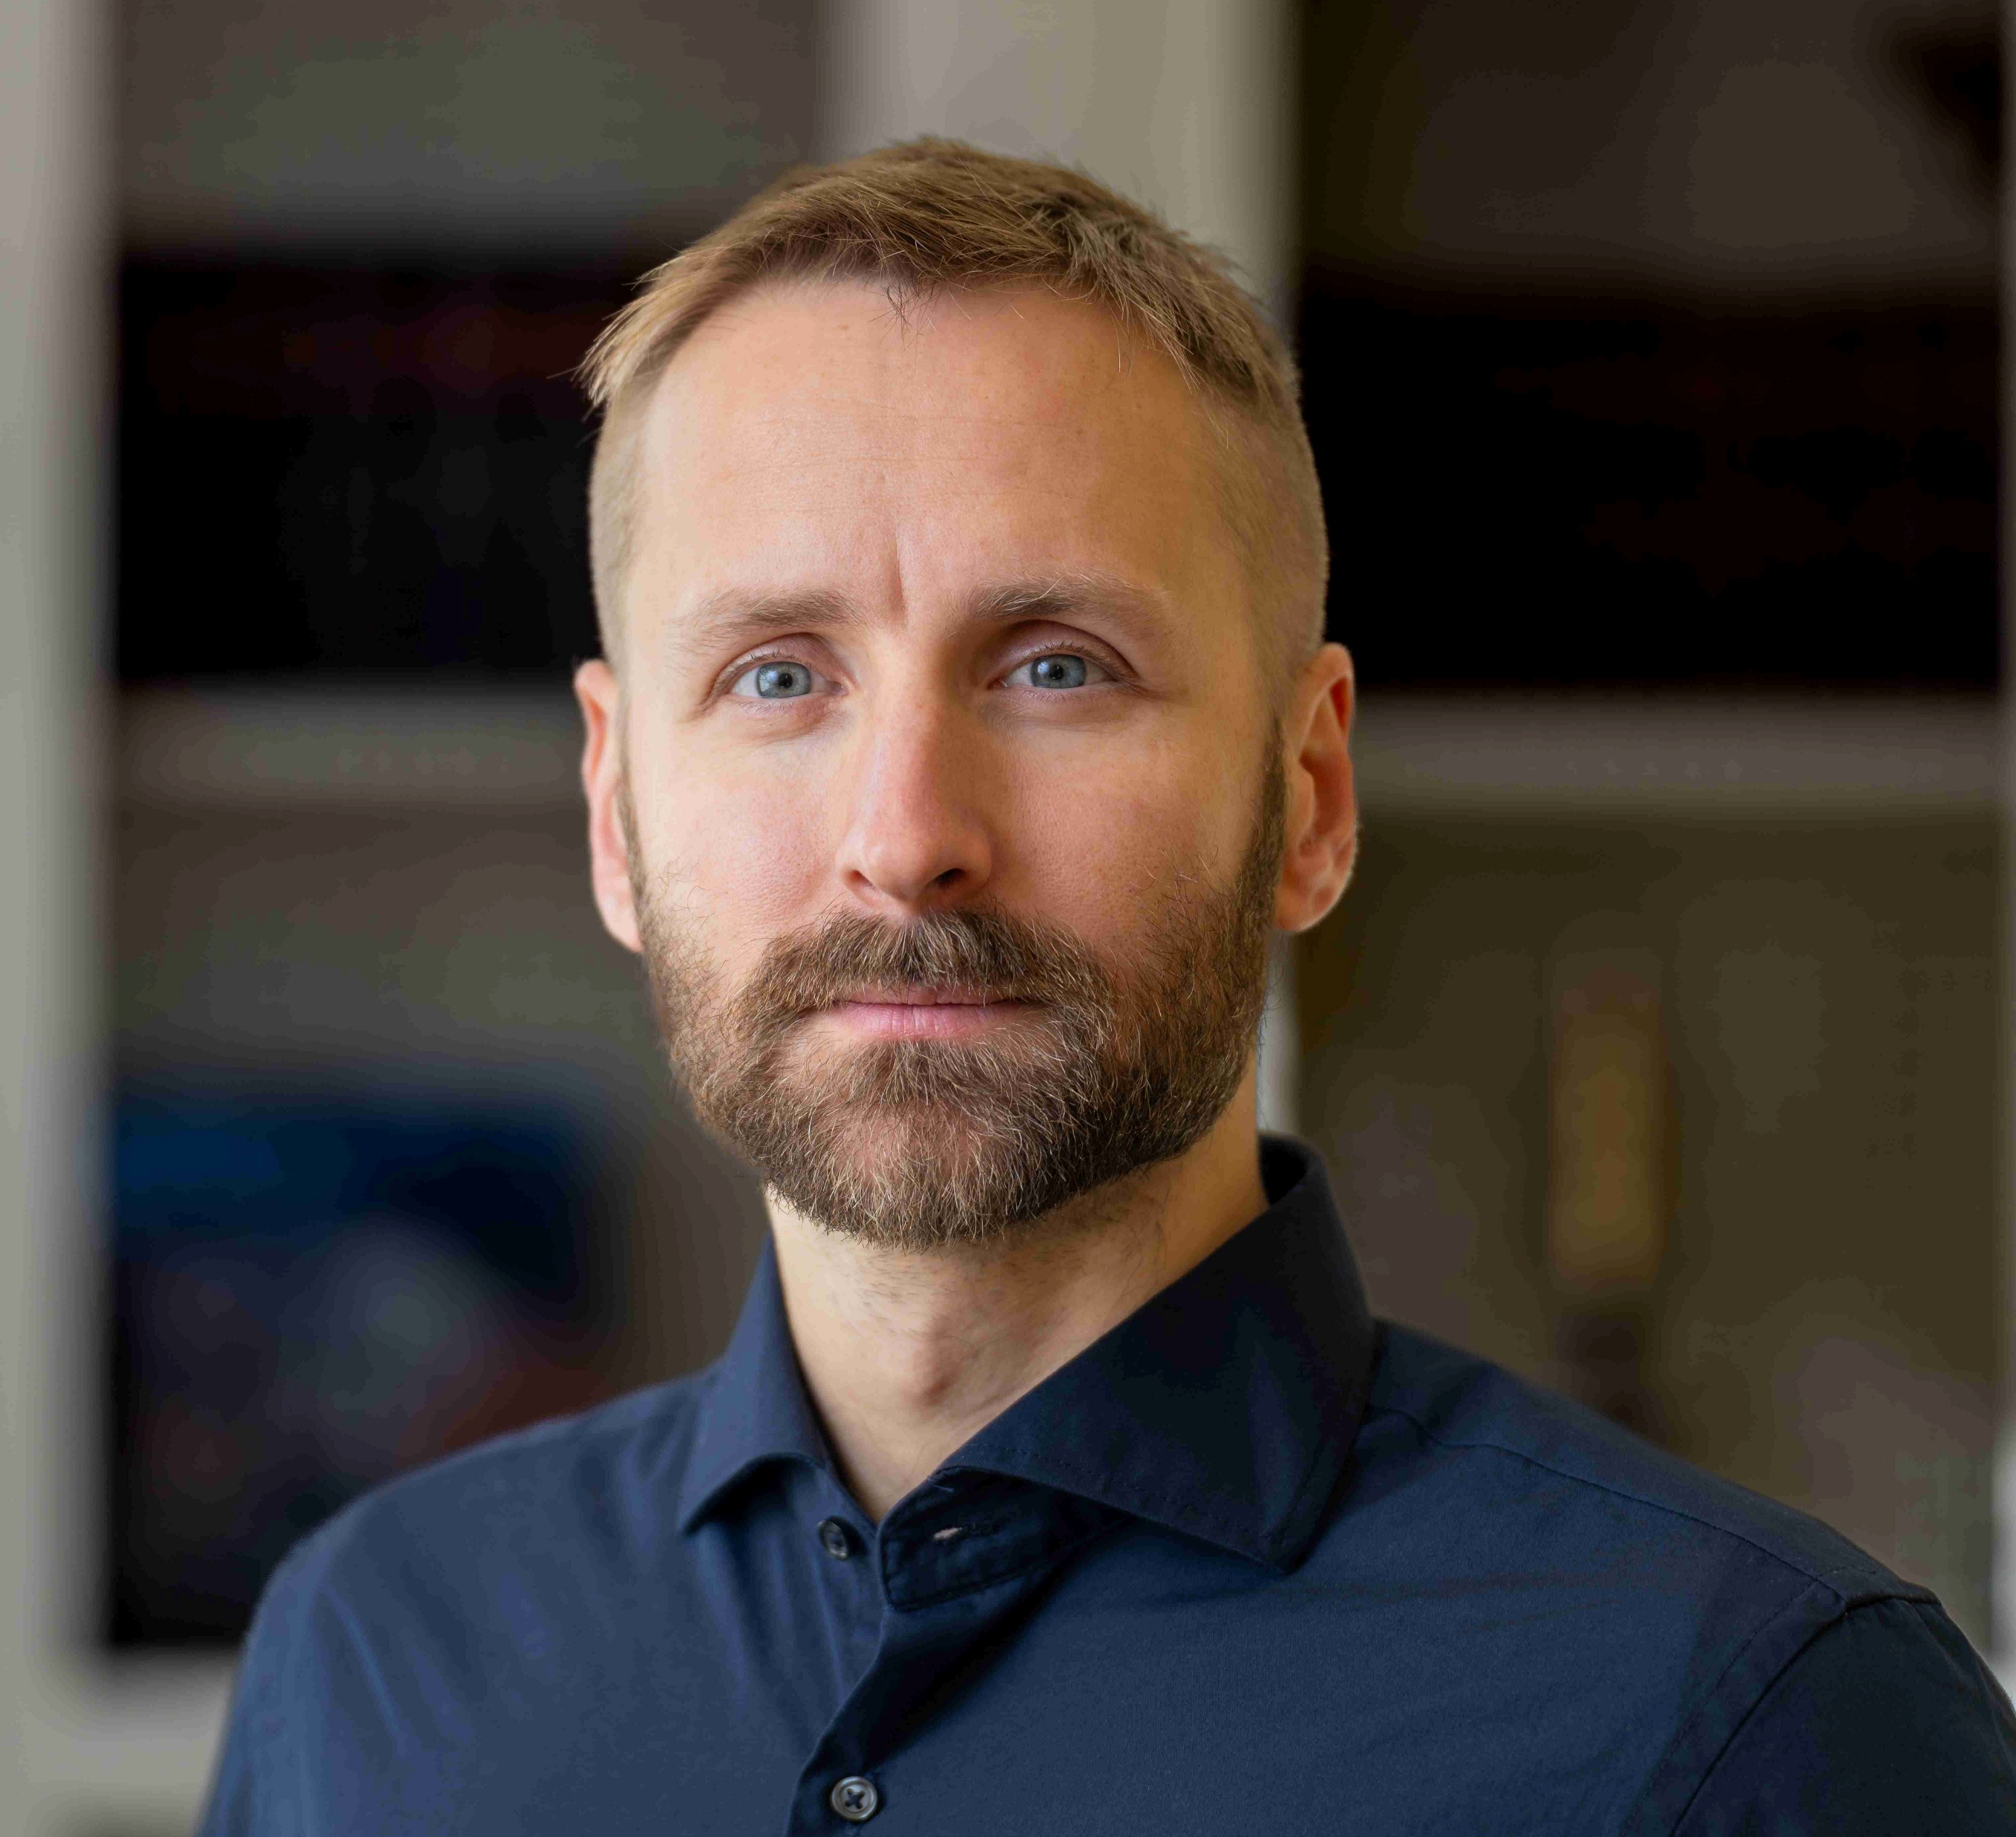


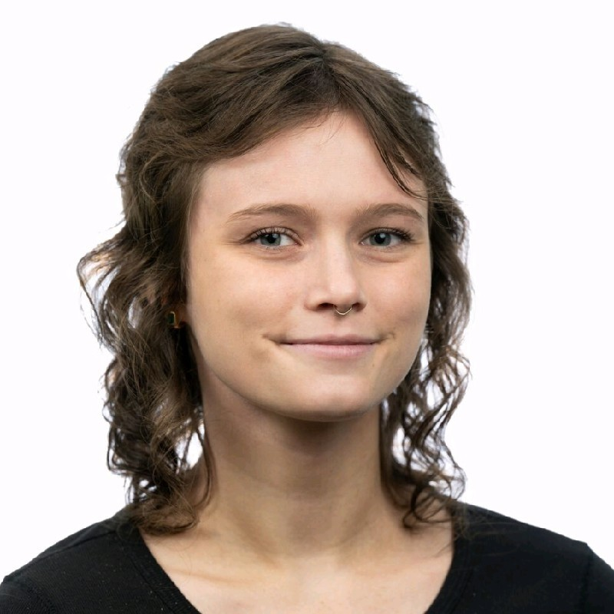

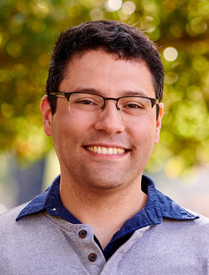
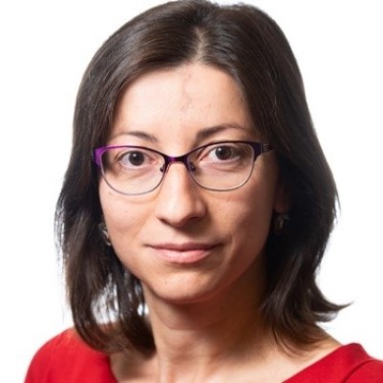



NeuroMANCER Team
Ján Drgoňa
Aaron Tuor
James Koch
Madelyn Shapiro
Rahul
Birmiwal
Bruno
Jacob
Draguna
Vrabie

Slide 20
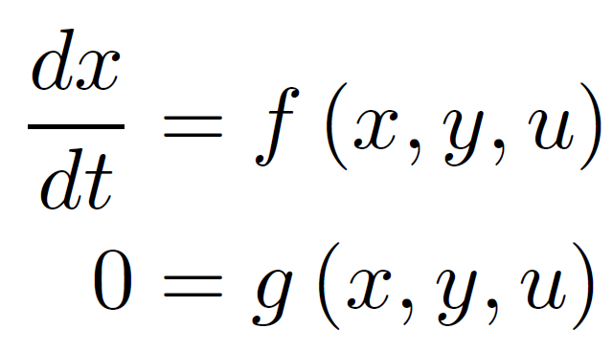
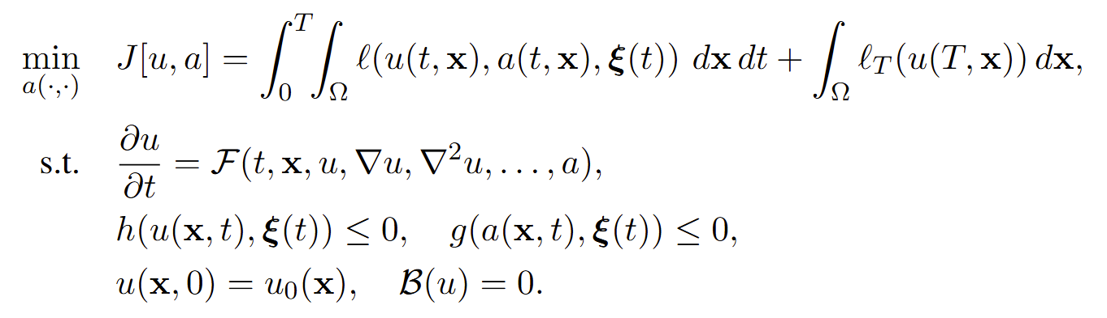
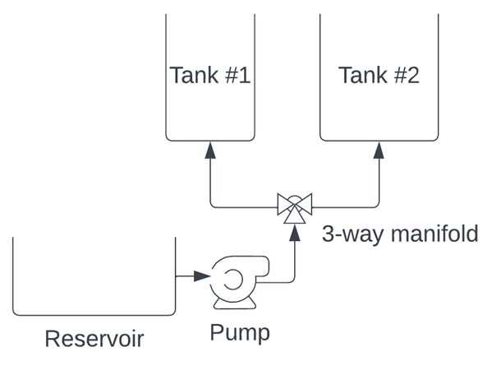
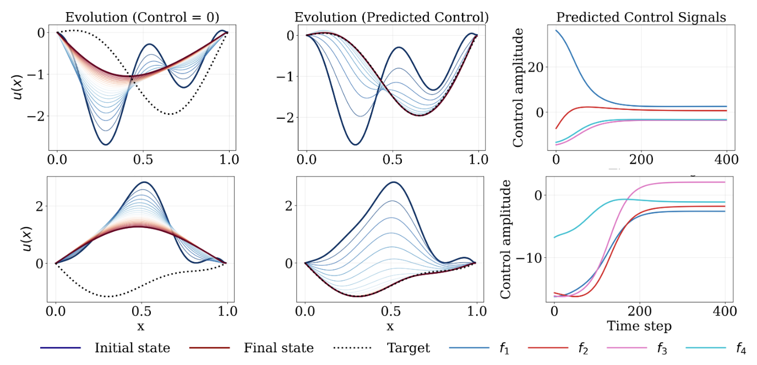
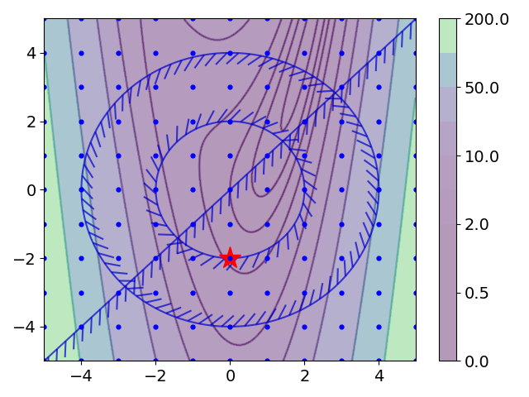
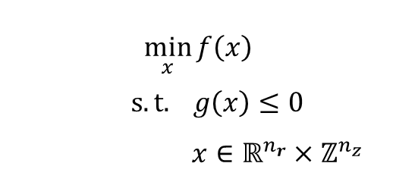
Some Open Challenges
Modeling of Differential
Algebraic Equations (DAEs)
Control of Partial Differential Equations (PDEs)
Mixed-Integer Decision Space
$$\min_{x}{f\left(x\right)}$$
$$s.t. g\left(x\right)≤0$$
$$x∈ℝ^{n_{r}}×ℤ^{n_{z}}$$
J. Koch, M. Shapiro, H. Sharma, D. Vrabie, J. Drgoňa, Learning Neural Differential Algebraic Equations via Operator Splitting, CDC, 2025.
D. R. Sharkar, J. Drgoňa, S. Goswami, "Learning to Control PDEs with Differentiable Predictive Control and Time-Integrated Neural Operators," under review, 2025
Bo Tang, Elias B. Khalil, Ján Drgoňa, Learning to Optimize for Mixed-Integer Non-linear Programming, arXiv:2410.11061, 2024

Slide 21
Some Open Challenges
Modeling of Differential
Algebraic Equations (DAEs)
Control of Partial Differential Equations (PDEs)
Mixed-Integer Decision Space
$$\min_{x}{f\left(x\right)}$$
$$s.t. g\left(x\right)≤0$$
$$x∈ℝ^{n_{r}}×ℤ^{n_{z}}$$
J. Koch, M. Shapiro, H. Sharma, D. Vrabie, J. Drgoňa, Learning Neural Differential Algebraic Equations via Operator Splitting, CDC, 2025.
D. R. Sharkar, J. Drgoňa, S. Goswami, "Learning to Control PDEs with Differentiable Predictive Control and Time-Integrated Neural Operators," under review, 2025
Bo Tang, Elias B. Khalil, Ján Drgoňa, Learning to Optimize for Mixed-Integer Non-linear Programming, arXiv:2410.11061, 2024

Slide 22


Neural Differential Algebraic Equations (NDAEs) Problem Formulation
DAE parameter estimation problem
Assumptions:
𝑓 is continuous in its arguments
𝑓 is Lipschitz continuous in 𝑥 on some neighborhood of initial conditions
constraints g are nonsingular
The Picard–Lindelöf theorem (also called the Cauchy–Lipschitz theorem) gives sufficient conditions under which an initial value problem (IVP) for an ordinary differential equation (ODE) has a unique solution.
[30] K. E. Brenan, S. L. Campbell, and L. R. Petzold, Numerical Solution of Initial-Value Problems in Differential-Algebraic Equations. SIAM, 1996.

Slide 23





Learning Neural Differential Algebraic Equations via Operator Splitting
Our neural DAE time stepper architecture is inspired by operator splitting methods for ODEs:
Neural DAE learning problem:
Lie-Trotter splitting scheme for ODEs:
Operator splitting for DAEs:
Picard-Lindelof Theorem for index-1 DAEs.
J. Koch, M. Shapiro, H. Sharma, D. Vrabie, J. Drgona, Learning Neural Differential Algebraic Equations via Operator Splitting, arXiv:2403.12938, 2024.

Slide 24



Tank-Manifold Pump Modeling Problem
Tank-manifold pump schematics
DAE with unknown components:
Neural DAE:
DAE inverse modeling, with satisfied conservation laws.
drgona.github.io/NeuralDAEs/
J. Koch, M. Shapiro, H. Sharma, D. Vrabie, J. Drgona, Learning Neural Differential Algebraic Equations via Operator Splitting, arXiv:2403.12938, 2024.

Slide 25

Co-Authors of Learning Neural Differential Algebraic Equations via Operator Splitting
James Koch
Madelyn Shapiro
Himanshu
Sharma
Draguna
Vrabie
Ján Drgoňa

Slide 26
Some Open Challenges
Modeling of Differential
Algebraic Equations (DAEs)
Control of Partial Differential Equations (PDEs)
Mixed-Integer Decision Space
$$\min_{x}{f\left(x\right)}$$
$$s.t. g\left(x\right)≤0$$
$$x∈ℝ^{n_{r}}×ℤ^{n_{z}}$$
J. Koch, M. Shapiro, H. Sharma, D. Vrabie, J. Drgoňa, Learning Neural Differential Algebraic Equations via Operator Splitting, CDC, 2025.
D. R. Sharkar, J. Drgoňa, S. Goswami, "Learning to Control PDEs with Differentiable Predictive Control and Time-Integrated Neural Operators," under review, 2025
Bo Tang, Elias B. Khalil, Ján Drgoňa, Learning to Optimize for Mixed-Integer Non-linear Programming, arXiv:2410.11061, 2024

Slide 27

Cardinality-Invariant Neural Operator Policies for Multi-Agent PDE Control
P. Zanotta, H. Zheng, D. R. Sharkar, S. Goswami, J. Drgoňa, Cardinality-Invariant Neural Operator Policies for Scalable PDE Control, under review, 2026, https://github.com/SOLARIS-JHU/Multi-Agent-DPC

Slide 28

Multi-agent PDE Control Problem
Parametric control functional
Time-dependent PDE operator
Actuator ODE dynamics
Sensor operator
Shared neural operator policy
Constraints
P. Zanotta, H. Zheng, D. R. Sharkar, S. Goswami, J. Drgoňa, Cardinality-Invariant Neural Operator Policies for Scalable PDE Control, under review, 2026, https://github.com/SOLARIS-JHU/Multi-Agent-DPC

Slide 29


PDE Control as Self-Supervised Neural Operator Learning
We learn the multi-agent policy operator using differentiable predictive control algorithm with differentiable PDE solvers.
P. Zanotta, H. Zheng, D. R. Sharkar, S. Goswami, J. Drgoňa, Cardinality-Invariant Neural Operator Policies for Scalable PDE Control, under review, 2026, https://github.com/SOLARIS-JHU/Multi-Agent-DPC

Slide 30

Empirical Results: Stabilization of 2D Kuramoto-Sivashinsky Chaos
P. Zanotta, H. Zheng, D. R. Sharkar, S. Goswami, J. Drgoňa, Cardinality-Invariant Neural Operator Policies for Scalable PDE Control, under review, 2026, https://github.com/SOLARIS-JHU/Multi-Agent-DPC

Slide 31

Empirical Results: Multi-agent Heat Control with Spatial Constraints
P. Zanotta, H. Zheng, D. R. Sharkar, S. Goswami, J. Drgoňa, Cardinality-Invariant Neural Operator Policies for Scalable PDE Control, under review, 2026, https://github.com/SOLARIS-JHU/Multi-Agent-DPC

Slide 32

Empirical Results: Density Transport in Advection-Diffusion
P. Zanotta, H. Zheng, D. R. Sharkar, S. Goswami, J. Drgoňa, Cardinality-Invariant Neural Operator Policies for Scalable PDE Control, under review, 2026, https://github.com/SOLARIS-JHU/Multi-Agent-DPC

Slide 33

Empirical Results: Solver Fidelity Robustness
The policy, trained on a coarse discretization of 64 × 64 (Top), is deployed zero-shot on a high-fidelity solver with 512 × 512 grid points (Bottom).
P. Zanotta, H. Zheng, D. R. Sharkar, S. Goswami, J. Drgoňa, Cardinality-Invariant Neural Operator Policies for Scalable PDE Control, under review, 2026, https://github.com/SOLARIS-JHU/Multi-Agent-DPC

Slide 34

Cardinality Invariance Across Diverse PDE Benchmarks
P. Zanotta, H. Zheng, D. R. Sharkar, S. Goswami, J. Drgoňa, Cardinality-Invariant Neural Operator Policies for Scalable PDE Control, under review, 2026, https://github.com/SOLARIS-JHU/Multi-Agent-DPC

Slide 35


Mean-Field Gradient Consistency
We train a shared neural operator policy on a finite swarm of size $M$,
but deploy it zero-shot on different swarm sizes. Key questions:
Does finite-$M$ training optimize the true continuous control problem?
Why does the policy transfer across cardinalities without knowing $M$?
We observe that training on a finite swarm asymptotically optimizes the continuous PDE control operator, not a particular agent configuration. Hence cardinality becomes a resolution parameter.
Our primary theoretical result establishes that the gradients computed during our discrete multi-agent training are consistent estimators of the gradients for this continuous limit.
P. Zanotta, H. Zheng, D. R. Sharkar, S. Goswami, J. Drgoňa, Cardinality-Invariant Neural Operator Policies for Scalable PDE Control, under review, 2026, https://github.com/SOLARIS-JHU/Multi-Agent-DPC

Slide 36

Mean-Field Gradient Consistency
Proof sketch: Proof relies on the discrete physics uniformly approximates the mean-field physics.
Uniform bounds: PDE states and adjoints remain uniformly bounded in suitable function space regardless of M, preventing blow-ups as agents are added.
Compactness and convergence: Using the Aubin-Lions lemma, we extract strongly convergent subsequences of the state trajectories, showing that the discrete dynamics converge to a unique mean-field limit.
Gradient Identification: We decompose the gradient error into a state-dependent term and a measure dependent term. We show both vanish in the limit, proving that optimizing the swarm is asymptotically equivalent to optimizing the continuous operator.
P. Zanotta, H. Zheng, D. R. Sharkar, S. Goswami, J. Drgoňa, Cardinality-Invariant Neural Operator Policies for Scalable PDE Control, under review, 2026, https://github.com/SOLARIS-JHU/Multi-Agent-DPC

Slide 37





Co-Authors of Cardinality-Invariant Neural Operator Policies for Scalable PDE Control
Pietro
Zanotta
Honghui
Zheng
Dibakar Roy
Sharkar
Somdatta
Goswami
Ján Drgoňa

Slide 38
Some Open Challenges
Modeling of Differential
Algebraic Equations (DAEs)
Control of Partial Differential Equations (PDEs)
Mixed-Integer Decision Space
$$\min_{x}{f\left(x\right)}$$
$$s.t. g\left(x\right)≤0$$
$$x∈ℝ^{n_{r}}×ℤ^{n_{z}}$$
J. Koch, M. Shapiro, H. Sharma, D. Vrabie, J. Drgoňa, Learning Neural Differential Algebraic Equations via Operator Splitting, CDC, 2025.
D. R. Sharkar, J. Drgoňa, S. Goswami, "Learning to Control PDEs with Differentiable Predictive Control and Time-Integrated Neural Operators," under review, 2025
Bo Tang, Elias B. Khalil, Ján Drgoňa, Learning to Optimize for Mixed-Integer Non-linear Programming, arXiv:2410.11061, 2024

Slide 39
Challenges of Existing Learning to Optimize Methods
1. Collecting Solutions as Training Labels for Supervised Learning is Very Expensive
Our Solution: Self-Supervised Learning Approach without requiring solutions for training.
2. Neural Networks Cannot Directly Output Integer Values
Our Solution: Differentiable Integer Correction Layers to ensure integer feasibility.
3. It is Difficult to Ensure Feasibility, Especially in Integers
Our Solution: Gradient-based Feasibility Projection to guarantee feasible integer solutions.
Selected Existing L2O methods Ferdinando Fioretto, et al., Predicting ac optimal power flows: Combining deep learning and lagrangian dual methods. AAAI conference on AI, 2020.
Priya Donti, et al., DC3: A learning method for optimization with hard constraints, ICLR, 2021
James Kotary, et al., End-to-end constrained optimization learning: A survey. arXiv preprint arXiv:2103.16378, 2021.
He He, et al., Learning to search in branch and bound algorithms. NeurIPS, 2014.
Elias Khalil, et al., Learning to branch in mixed integer programming. AAAI Conference on AI, 2016.
Maxime Gasse, et al., Exact combinatorial optimization with graph convolutional neural networks. NeruIPS, 2019.
Timo Berthold , et al., Learning to scale mixed-integer programs. AAAI Conference on AI, 2021.
Yoshua Bengio, et al., Machine learning for combinatorial optimization: a methodological tour d’horizon. European Journal of Operational Research, 2021.
Dimitris Bertsimas and Bartolomeo Stellato. Online mixed-integer optimization in milliseconds. INFORMS Journal on Computing, 2022.

Slide 40



Learning to Optimize for Mixed-Integer Nonlinear Programming
Learning problem formulation:
Penalty loss function reformulation:
Amortized optimization allows scaling to some of the largest MINLPs.
Could also be used as primal heuristics.
Bo Tang, Elias B. Khalil, Ján Drgoňa, Learning to Optimize for Mixed-Integer Non-linear Programming, arXiv:2410.11061, 2024

Slide 41

Learning to Optimize for Mixed-Integer Nonlinear Programming
Learning problem formulation:
Penalty loss function reformulation:
Parameters $ξ$ influence the objective and constraints of the optimization problem. We sample a set of problems from a distribution.
Bo Tang, Elias B. Khalil, Ján Drgoňa, Learning to Optimize for Mixed-Integer Non-linear Programming, arXiv:2410.11061, 2024

Slide 42

Learning to Optimize for Mixed-Integer Nonlinear Programming
Learning problem formulation:
Penalty loss function reformulation:
We aim to predict the solution $\hat{x}$ with machine learning model $ψ_{Θ}$ with inputs $ξ$ and weights $Θ.$
Bo Tang, Elias B. Khalil, Ján Drgoňa, Learning to Optimize for Mixed-Integer Non-linear Programming, arXiv:2410.11061, 2024

Slide 43
Learning to Optimize for Mixed-Integer Nonlinear Programming
Learning problem formulation:
Penalty loss function reformulation:
Until now this is standard self-supervised L2O for continuous problems.
Bo Tang, Elias B. Khalil, Ján Drgoňa, Learning to Optimize for Mixed-Integer Non-linear Programming, arXiv:2410.11061, 2024

Slide 44
Learning to Optimize for Mixed-Integer Nonlinear Programming
Learning problem formulation:
Penalty loss function reformulation:
Main innovation of the paper: Integer correction layers and integer feasibility projection
Bo Tang, Elias B. Khalil, Ján Drgoňa, Learning to Optimize for Mixed-Integer Non-linear Programming, arXiv:2410.11061, 2024

Slide 45


Differentiable Integer Correction Layers
Learnable end-to-end extension of the Relaxation Enforced Neighborhood Search (RENS).
Bo Tang, Elias B. Khalil, Ján Drgoňa, Learning to Optimize for Mixed-Integer Non-linear Programming, arXiv:2410.11061, 2024

Slide 46

Differentiable Integer Correction Layers: RC Example
Bo Tang, Elias B. Khalil, Ján Drgoňa, Learning to Optimize for Mixed-Integer Non-linear Programming, arXiv:2410.11061, 2024

Slide 47


Integer Feasibility Projection
Learning-based alternative to Feasibility Pump which also alternates between rounding and projection.
Bo Tang, Elias B. Khalil, Ján Drgoňa, Learning to Optimize for Mixed-Integer Non-linear Programming, arXiv:2410.11061, 2024

Slide 48

Approximate Feasibility Guarantees for Integer Projection
Bo Tang, Elias B. Khalil, Ján Drgoňa, Learning to Optimize for Mixed-Integer Non-linear Programming, arXiv:2410.11061, 2024

Slide 49


L2O for MINLP: Comparison with SOTA Solvers
Exact solvers such as Gurobi and SCIP can find better solutions over time but are slow. In contrast, our methods achieve high-quality feasible solutions within milliseconds. Our methods provide up to 5 orders of magnitude speedup.
https://github.com/pnnl/L2O-pMINLP
Bo Tang, Elias B. Khalil, Ján Drgoňa, Learning to Optimize for Mixed-Integer Non-linear Programming, arXiv:2410.11061, 2024

Slide 50

Effect of Penalty Weights and Integer Projections on Feasibility
Our approach achieves comparable or better feasible solutions compared to exact solvers.
https://github.com/pnnl/L2O-pMINLP
Bo Tang, Elias B. Khalil, Ján Drgoňa, Learning to Optimize for Mixed-Integer Non-linear Programming, arXiv:2410.11061, 2024

Slide 51




Co-Authors of Learning to Optimize for Mixed-Integer Non-Linear Programming
Bo Tang
PhD Candidate
Department of Mechanical & Industrial Engineering
University of Toronto
Elias B. Khalil
Assistant Professor
Department of Mechanical & Industrial Engineering
University of Toronto
Ján Drgoňa
Associate Professor
Department of Civil and Systems
Johns Hopkins University

Slide 52





Liang Wu
Education & experiences
2018-2023, PhD, IMT Lucca 2023-2025, Postdoc at MIT
2025-present, Postdoc at JHU
Optimization
$$\min{f\left(x\right)}$$
$$\frac{dz}{dt}=F(z)$$
Analog physical system
$$s.t. g\left(x\right)≤0$$
[8] L. Wu, et. al., “Arbitrarily Small Execution-Time Certificate: what was missed in Analog Optimization”, in IEEE TAC, 2025.
[*] L. Wu, “XCo: A Factorization-free ADMM Solver for Extreme-scale Conic Optimization”, ongoing.
[*] L. Wu, “CCQP: An Efficient Complementarity Constrained Optimization Program Solver for Mixed-Integer MPC”, ongoing.
Control
Fast MPC algorithms:
[*] L. Wu, et. al., “πMPC: A Parallel-in-horizon and Construction-free NMPC Solver”, under review by IEEE TAC.
[2] L. Wu, et. al., “Koopman-BoxQP: solving large-scale NMPC problems at kHZ Rate”, accepted by L4DC 2026.
[3] L. Wu and A. Bemporad, “A Simple and Fast Coordinate-Descent Augmented-Lagrangian Solver for Model Predictive Control” IEEE TAC, 2023.
Learning
Learning to Model
[*] L. Wu et al., “A Least-Squares Multi-Step Koopman Operator for Model Predictive Control”, submitted to Automatica.
Address the open challenge in MPC: Execution time certificate
[4] L. Wu and R.D. Braatz, “A Direct Optimization Algorithm for Input-Constrained MPC”, in IEEE TAC, 2025.
[5] L. Wu and R.D. Braatz, “A Quadratic Programming Algorithm with $O(n^{3})$ Time Complexity”, in IEEE TAC (in press).
[6] L. Wu, et. al., “EIQP: Execution-time-certified and Infeasibility-detecting QP Solver", in IEEE TAC, 2025
[7] L. Wu, et. al., “A Time-certified Predictor-corrector IPM Algorithm for Box-QP”, in IEEE Control Systems Letters, 2025.
Learning to Optimize
[*] L. Wu, “A Trustworthy and Self-supervised Online/Offline Neural Convex Optimization (and HJB) Solver”, ongoing.
Optimizer for DNN Training
[*] L. Wu, “Modern EKF Optimizer for Large-scale Deep Neural Networks”, ongoing.

Slide 53

Summary
Scientific machine learning (SciML) methods integrating deep learning, constrained optimization, physics-based modeling, and control
Learning to solve (L2S)
Learning to optimize (L2O)
Learning to model (L2M)
Learning to control (L2C)
Challenges
Mixed-integer equality constraints
Gradients ill conditioning for deep graphs
Offline pre-training vs online adaptation
Computational cost of guarantees
Opportunities
PDE optimization and control via Geometric Neural Operators (GNO) and Koopman Operators (KO)
Development of new software tools
SciML Course
https://github.com/drgona/SciML-Course
drgona.github.io/
jdrgona1@jh.edu

Slide 54




DPC vs Model-based Reinforcement Learning
DPC is closely related to MBRL in that both leverage model of dynamics, but DPC utilizes differentiable closed-loop models and cost functions, allowing direct policy gradients without requiring a learned critic.
Empirical risk minimization problem:
Critic parametrized by differentiable MPC loss function:
Policy gradient via automatic differentiation:
J. Drgoňa, A. Tuor and D. Vrabie, Learning Constrained Parametric Differentiable Predictive Control Policies With Guarantees, in IEEE Transactions on Systems, Man, and Cybernetics: Systems, 2024
J. Drgoňa, et al., Differentiable Predictive Control: An MPC Alternative for Unknown Nonlinear Systems using Constrained Deep Learning, Journal of Process Control, 2022

Slide 55

DPC vs Model Predictive Control
DPC is also closely related to MPC, but instead of single instance online optimization, the DPC learns parametric explicit policy offline, over distribution of parametric instances in batched setting.
There is a structural equivalence between single shooting formulation of MPC problem and the unrolled closed-loop system dynamics in DPC.
DPC is also related to explicit MPC, as it solves a parametric optimal control problem via gradient-based policy optimization.
J. Drgoňa, A. Tuor and D. Vrabie, Learning Constrained Parametric Differentiable Predictive Control Policies With Guarantees, in IEEE Transactions on Systems, Man, and Cybernetics: Systems, 2024
J. Drgoňa, et al., Differentiable Predictive Control: An MPC Alternative for Unknown Nonlinear Systems using Constrained Deep Learning, Journal of Process Control, 2022

Slide 56

Learning to Control PDEs with DPC and Neural Operators
D. R. Sharkar, J. Drgoňa, S. Goswami, "Learning to Control PDEs with Differentiable Predictive Control and Time-Integrated Neural Operators," arXiv:2511.08992, 2025

Slide 57





Time-Integrated Neural Operator (TI-DeepOnet)
TI-DeepOnet: PDE surrogate based on method-of-lines spatial discretization
⊙ denotes element-wise multiplication
is a state branch net encoding the state field
is a control branch net encoding the control function
is a trunk net encoding the solution at the collocation points
D. R. Sharkar, J. Drgoňa, S. Goswami, "Learning to Control PDEs with Differentiable Predictive Control and Time-Integrated Neural Operators," arXiv:2511.08992, 2025

Slide 58

Formulation of DPC with TI-DeepOnet
Discretize then optimize reformulation of the PDE control problem:
D. R. Sharkar, J. Drgoňa, S. Goswami, "Learning to Control PDEs with Differentiable Predictive Control and Time-Integrated Neural Operators," arXiv:2511.08992, 2025

Slide 59

Training Algorithms for TI-DeepOnet and DPC
JAX implementation: https://github.com/Centrum-IntelliPhysics/PDEControl_DPC
D. R. Sharkar, J. Drgoňa, S. Goswami, "Learning to Control PDEs with Differentiable Predictive Control and Time-Integrated Neural Operators," arXiv:2511.08992, 2025

Slide 60

Learning to Control PDEs with DPC and Neural Operators
Heat equation tracking control
Fisher-KPP population density control
D. R. Sharkar, J. Drgoňa, S. Goswami, "Learning to Control PDEs with Differentiable Predictive Control and Time-Integrated Neural Operators," arXiv:2511.08992, 2025

Slide 61
Co-Authors of Learning to Control PDEs with Differentiable Predictive Control and Time-Integrated Neural Operators
Dibakar Roy Sharkar
Ján Drgoňa
Somdatta Goswami

Slide 62



Mixed-Integer Differentiable Predictive Control
Ján Boldocký, Shahriar Dadras Javan, Martin Gulan, Martin Mönnigmann, Ján Drgoňa, "Learning to Solve Parametric Mixed-Integer Optimal Control Problems via Differentiable Predictive Control," arXiv:2506.19646, 2025

Slide 63






Co-Authors of Mixed-Integer Differentiable Predictive Control
Ján Boldocký
Shahriar Dadras Javan
Martin Gulan
Martin Mönnigmann
Ján Drgoňa

Slide 64


Learning to Control Building Energy System
Benefits of Scientific Machine Learning
Modeling and optimal control design is roughly 10-times faster and requires less expertise.
Real-time decisions are made orders of magnitude faster than traditional model-based approaches.
J. Drgona, et al., Physics-constrained deep learning of multi-zone building thermal dynamics, Energy and Buildings, 2021
J. Drgona, et al., Deep Learning Explicit Differentiable Predictive Control Laws for Buildings, IFAC NMPC 2021

Slide 65

Learning to Control Power System
Benefits of Scientific Machine Learning
Fast prototyping by re-using code template from building control project.
Real-time decisions are made orders of magnitude faster than traditional model-based approaches.
Ethan King, et al., Koopman-based Differentiable Predictive Control for the Dynamics-Aware Economic Dispatch Problem, American Control Conference 2022

Slide 66

Asymptotic Guarantees of Integer Feasibility Projection
Bo Tang, Elias B. Khalil, Ján Drgoňa, Learning to Optimize for Mixed-Integer Non-linear Programming, arXiv:2410.11061, 2024

Slide 67

Non-Asymptotic Guarantees of Integer Feasibility Projection
Bo Tang, Elias B. Khalil, Ján Drgoňa, Learning to Optimize for Mixed-Integer Non-linear Programming, arXiv:2410.11061, 2024

Slide 68

Non-Asymptotic Guarantees of Integer Feasibility Projection
Bo Tang, Elias B. Khalil, Ján Drgoňa, Learning to Optimize for Mixed-Integer Non-linear Programming, arXiv:2410.11061, 2024

Slide 69

Effect of Penalty Weight
Integer feasibility projection (RC-P and LT-P), improves feasibility even with smaller penalty weights. Without projection there is a trade-off between feasibility and objective values (RC and LT).
Bo Tang, Elias B. Khalil, Ján Drgoňa, Learning to Optimize for Mixed-Integer Non-linear Programming, arXiv:2410.11061, 2024

Slide 70
Benchmark Methods
Method | Description
EX (Exact Solver) | Solves problems exactly using traditional solver with 1000-sec time-limit as a benchmark.
N1 (Root Node Solution) | Finds the first feasible solution from the root node of the solver, combining various heuristics.
RC (Rounding Classification) | A neural network-based correction layer that learns a classification to determine how to round each integer variable.
LT (Learnable Thresholding) | A neural network-based correction layer that learns a threshold value to decide to round up or down for each integer variable.
RC-P (RC + Feasibility Projection) | RC combined with feasibility projection, which corrects infeasibilities while preserving integer constraints.
LT-P (LT + Feasibility Projection) | LT combined with feasibility projection, which corrects infeasibilities while preserving integer constraints.
Bo Tang, Elias B. Khalil, Ján Drgoňa, Learning to Optimize for Mixed-Integer Non-linear Programming, arXiv:2410.11061, 2024

Slide 71

L2O for MINLP: Empirical Evaluation
Integer Quadratic Problems (IQPs). Each problem size is evaluated on a test set of 100 instance.
Method | RC |  |  |  | RC-P |  |  |  | LT
Metric | Obj Mean | Obj Median | % Feasible | Time (Sec) | Obj Mean | Obj Median | % Feasible | Time (Sec) | Obj Mean | Obj Median | % Feasible | Time (Sec)
100×100 | -13.54 | -13.6 | 96% | 0.0022 | -13.54 | -13.57 | 100% | 0.005 | -13.65 | -13.77 | 93% | 0.0023
200×200 | -31.62 | -31.71 | 97% | 0.0021 | -31.62 | -31.71 | 100% | 0.005 | -31.34 | -31.61 | 95% | 0.0022
500×500 | -73.31 | -73.38 | 86% | 0.0025 | -73.31 | -73.38 | 100% | 0.0065 | -72.36 | -72.48 | 94% | 0.0026
1000×1000 | -142.7 | -142.7 | 82% | 0.0042 | -142.7 | -142.7 | 100% | 0.009 | -142.6 | -142.6 | 100% | 0.0047
Method | LT-P |  |  |  | EX |  |  |  | N1
Metric | Obj Mean | Obj Median | % Feasible | Time (Sec) | Obj Mean | Obj Median | % Feasible | Time (Sec) | Obj Mean | Obj Median | % Feasible | Time (Sec)
100×100 | -13.65 | -13.77 | 100% | 0.01 | -20.79 | -20.78 | 100% | 1237 | 1.5E+18 | 1.4E+18 | 100% | 104.2
200×200 | -31.34 | -31.61 | 100% | 0.0064 | - | - | - | - | - | - | - | -
500×500 | -72.36 | -72.48 | 100% | 0.0063 | - | - | - | - | - | - | - | -
1000×1000 | -142.6 | -142.6 | 100% | 0.0086 | - | - | - | - | - | - | - | -
Bo Tang, Elias B. Khalil, Ján Drgoňa, Learning to Optimize for Mixed-Integer Non-linear Programming, arXiv:2410.11061, 2024

Slide 72

L2O for MINLP: Empirical Evaluation
Integer Non-convex Problems (INPs). Each problem size is evaluated on a test set of 100 instance.
Method | RC |  |  |  | RC-P |  |  |  | LT
Metric | Obj Mean | Obj Median | % Feasible | Time (Sec) | Obj Mean | Obj Median | % Feasible | Time (Sec) | Obj Mean | Obj Median | % Feasible | Time (Sec)
100×100 | 1.664 | 1.594 | 100% | 0.0022 | 1.664 | 1.594 | 100% | 0.0060 | 0.669 | 0.649 | 96% | 0.0021
200×200 | 1.472 | 1.436 | 99% | 0.0022 | 1.471 | 1.436 | 100% | 0.0054 | -0.356 | -0.373 | 100% | 0.0023
500×500 | 0.526 | 0.526 | 96% | 0.0029 | 0.524 | 0.526 | 100% | 0.0061 | -1.374 | -1.594 | 98% | 0.0029
1000×1000 | 1.423 | 0.809 | 97% | 0.0040 | 1.423 | 0.809 | 100% | 0.0115 | -3.744 | -3.716 | 99% | 0.0050
Method | LT-P |  |  |  | EX |  |  |  | N1
Metric | Obj Mean | Obj Median | % Feasible | Time (Sec) | Obj Mean | Obj Median | % Feasible | Time (Sec) | Obj Mean | Obj Median | % Feasible | Time (Sec)
100×100 | 0.669 | 0.649 | 100% | 0.0058 | 256.93 | 134.62 | 14% | 1001 | 4411 | 155.2 | 14% | 940.4
200×200 | -0.356 | -0.373 | 100% | 0.0056 | - | - | - | - | - | - | - | -
500×500 | -1.374 | -1.594 | 100% | 0.0072 | - | - | - | - | - | - | - | -
1000×1000 | -3.744 | -3.716 | 100% | 0.0117 | - | - | - | - | - | - | - | -
Bo Tang, Elias B. Khalil, Ján Drgoňa, Learning to Optimize for Mixed-Integer Non-linear Programming, arXiv:2410.11061, 2024

Slide 73


L2O for MINLP: Empirical Evaluation
Mixed-integer Rosenbrock Problems (MIRBs). Each problem size is evaluated on a test set of 100 instance.
Method | RC |  |  |  | RC-P |  |  |  | LT
Metric | Obj Mean | Obj Median | % Feasible | Time (Sec) | Obj Mean | Obj Median | % Feasible | Time (Sec) | Obj Mean | Obj Median | % Feasible | Time (Sec)
20×4 | 59.39 | 48.86 | 100% | 0.0019 | 59.39 | 48.86 | 100% | 0.0048 | 62.51 | 63.40 | 100% | 0.0020
200×4 | 503.5 | 461.7 | 99% | 0.0021 | 504.2 | 461.7 | 100% | 0.0052 | 622.8 | 626.0 | 100% | 0.0026
50×4 | 5938 | 5792 | 99% | 0.0033 | 5942 | 5792 | 100% | 0.0070 | 5612 | 5558 | 97% | 0.0030
1000×4 | 6.7E+4 | 6.7E+4 | 76% | 0.0121 | 9.8E+4 | 7.3E+4 | 100% | 0.0824 | 4.8E+4 | 3.5E+4 | 66% | 0.0127
Method | LT-P |  |  |  | EX |  |  |  | N1
Metric | Obj Mean | Obj Median | % Feasible | Time (Sec) | Obj Mean | Obj Median | % Feasible | Time (Sec) | Obj Mean | Obj Median | % Feasible | Time (Sec)
20×4 | 62.51 | 63.40 | 100% | 0.0055 | 64.67 | 59.16 | 100% | 1005 | 87.83 | 77.34 | 100% | 0.0813
200×4 | 622.8 | 626.0 | 100% | 0.0062 | 8.4E+5 | 908.8 | 100% | 1002 | 3.7E+8 | 957.4 | 100% | 0.2608
2000×4 | 5615 | 5558 | 100% | 0.0071 | 4.7E+10 | 9262 | 96% | 1002 | 8.3E+12 | 9379 | 95% | 71.91
20000×4 | 8.0E+4 | 4.5E+4 | 100% | 0.0639 | 1.1E+15 | 1.0E5 | 78% | 1040 | 1.2E+15 | 1.0E5 | 78% | 782.1
Bo Tang, Elias B. Khalil, Ján Drgoňa, Learning to Optimize for Mixed-Integer Non-linear Programming, arXiv:2410.11061, 2024

Slide 74




Metric Learning to Accelerate Convergence of Operator Splitting Methods
Parametric programming setting:
Douglas-Rachford splitting (DR) algorithm:
We can accelerate convergence of DR and ADMM algorithms via end-to-end metric learning.
Idea: Train neural network to optimize the metric as a function of problem parameters:
Ethan King, James Kotary, Ferdinando Fioretto, Jan Drgona, Metric Learning to Accelerate Convergence of Operator Splitting Methods for Differentiable Parametric Programming, Under review for CDC 2024.

Slide 75


Metric Learning is a Form of Active Set Prediction
Ethan King, James Kotary, Ferdinando Fioretto, Jan Drgona, Metric Learning to Accelerate Convergence of Operator Splitting Methods for Differentiable Parametric Programming, Under review for CDC 2024.

Slide 76
TODO: change this slide to be motivating and more flashy
DAE parameter estimation problem:
Assumptions:
𝑓 is continuous in both 𝑡 and 𝑥
𝑓 is Lipschitz continuous in 𝑥 on some neighborhood of initial conditions
The Picard–Lindelöf theorem (also called the Cauchy–Lipschitz theorem) gives sufficient conditions under which an initial value problem (IVP) for an ordinary differential equation (ODE) has a unique solution.
[30] K. E. Brenan, S. L. Campbell, and L. R. Petzold, Numerical Solution of Initial-Value Problems in Differential-Algebraic Equations. SIAM, 1996.
https://github.com/pnnl/NeuralDAEs
J. Koch, M. Shapiro, H. Sharma, D. Vrabie, J. Drgona, Learning Neural Differential Algebraic Equations via Operator Splitting, arXiv:2403.12938, 2024.

Slide 77



Networked Dynamical Systems via Universal Differential Equations (UDEs)
Network of unknown oscillators
Coupling adjacency
Generalization of learned dynamics on never-seen network topology.
Ground truth Kuramoto system:
James Koch, et al., Structural Inference of Networked Dynamical Systems with Universal Differential Equations, Chaos: An interdisciplinary Journal of Nonlinear Science, doi.org/10.1063/5.0109093, 2023

